Slide 1
Taila Bindu Pariksha Research, Results & Models
- Anmol Bansal

Slide 2
Introduction
After carefully studying the resources and research papers, I have come to the conclusion that making the dataset is the most difficult part.
The models can be applied as we go deeper into the dataset and how the dataset has values.
Mostly the dataset will be having images, which we can process using shape detection methods.
But we can work on side dataset values as well. Ex – Viscosity of liquid, temperature, time to capture the results etc.

Slide 3
Research Papers
Mostly research papers were well-versed with how the process works and most content was revolving around the technique only.
Nobody implemented ML-models and as such there dataset was also very limited for 30-40 people on an average.
With models to be trained we need data of at least 5000-10000 data points. As we need high accuracy and it should be working as accurate as other expensive technological methods work.
Now, we will see how other research papers elaborate there techniques and methods which we can use to start with model building.

Slide 4
R1: Assessment of prognostic aspects of cancer by Taila Bindu Pariksha.
This paper tried to relate the taila bindu pariksha with cancer, but came up with only methods and a big “can be used” observation.
They tried to compare with a very old technology called ECOG scale.
They found out that taila bindu is good and estimates close values equal to ECOG scale.
Here as defined in the ancient texts that circular/oval is good and irregular is bad.
There observation table was something like this ->

Slide 5
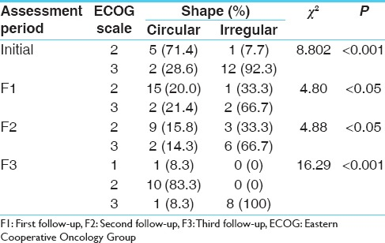
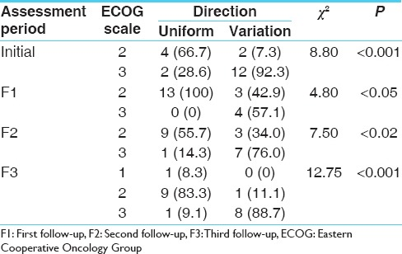
Observation Table:
With these observations at hand the results of this paper was that for cancer prognosis this process can be used.

Slide 6
R2: A study on the method of Taila Bindu Pariksha (oil drop test)
This paper basically aims to standardize the procedure by standardizing these:
Shape and size of Patra (testing containers), Volume of the urine, Size of the oil drop, Height of the oil drop from the surface of urine, Duration between collection and performance of test andType of Tila Taila for test.
They observed parameters like, Shape of oil after spread, Direction of spread, Spread time and spilt time, Area Covered.

Slide 7
Results and Usage
These standardizations need further evaluation and verification on different and more samples.
We can use these standards by further refining them with our own dataset’s research and can implement these in the model as a standard bar for the results.
This will not only improve the accuracy but it will also help in increasing the authenticity of this project.

Slide 8
R3: Important aspect of ayurvedic taila bindu pariksha to assesses disease prognosis.
This resource is basically an article and lays out all the procedures of taila-pariksha.
It also tells the following parameters in detail:
Shape of the oil drop after spread.
Direction of the oil drop spread
Rate of the oil drop spread.
These values can be used while building the models and can be easily organized with the standard methods we got from the resource 2.

Slide 9
R4: Standardization of taila bindu pareeksha
This resource standardized procedure is 30 ml urine sample taken in circular shaped glass vessel of circumference 12.2 inches. Taila extracted from Krishna Tila, with drop size being 12µl pipetted from 50µl micropipette dropped from a height of 1cm from the surface of urine and various characters exhibited by oil drop while spreading on urine be noted and analysed.
These were the results of the IAMJ research paper and these in accordance with standardization of resource 2 can be used.
It mentions 30 ml urine sample but mostly papers mentions 200 ml therefore we can go with 200 ml

Slide 10
R5: Taila Bindu Pariksha: An Ayurvedic Prognostic Tool
This paper was a unique one other than the mentioned above 4 resources. This evaluates the prognosis of disease and assessment of dosha involved in the disease, which was just mentioned in the R4 as well.
All the standards were followed by this method like black tila oil, 200 ml urine sample, drop size 12 (micro-liter).
The results were - needs to modify with the status of disease. This method which is very cost effective may be proved to be useful technique in medical field.

Slide 11
R6: Study of taila bindu pariksha on artificial urine
This was also a unique resource and I find it quite interesting where artificial urine was used to compare with actual urine. They found out that the taila is very fast and within 1 second, it spread quickly to the sides of the petri dish. With this no observations were recorded as it was difficult to record and capture the effect.
Oil spread is dependent on metabolites present in the urine in small quantities. Exact nature of minor constituents responsible for the spread is still unknown and to be further researched.
This feature can be used as well, we can further deep dive in the project and try to find what makes the taila move and give results.

Slide 12
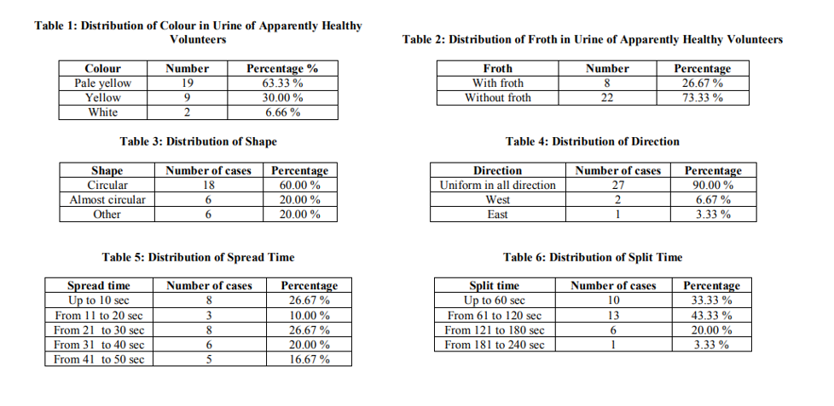
R7: A study on the method of Taila Bindu Pariksha (oil drop test)
This research paper was focused on healthy people and the observations were like this:

Slide 13
Results and usage:
We can see that this paper gave us 6 tables with 6 different parameters.
We can use these parameters and make our model only focus on these, for shape distribution and direction we can use shape detection methods.
For other parameters like color, froth, split time and spread time we can use normal statistical methods and probabilistic methods.

Slide 14
R8: Study of Taila Bindu Pariksha: A Diagnostic Method and Prognostic Tool
This paper laid down the proper doshas according to the Tail-bindu appearance.
It not only give the technique of taila bindu but also important aspects of the methods like.
Oil spreads in different disease.
Shape of oil spread in different disease.
Urine appearance in various disease.
With this we can say that other aspects of this method can be explored and multiple side results can also be given.

Slide 15
Conclusion
Models can only be applied with high accuracy only if our dataset is good. With this we can say our most important concern should be data collection and data pre processing.
With this step done we’re halfway through and can say that models can now be implemented.
The above research papers gave us the better insight on the technique but not a single mentions any models or technical part.
We have to search for better models and boosting algorithms to get a perfect result.

Slide 16
Thank you

